Slide 1
Boundary Points of the Test Track
Aneesh Batchu
September 4th, 2024

Slide 2
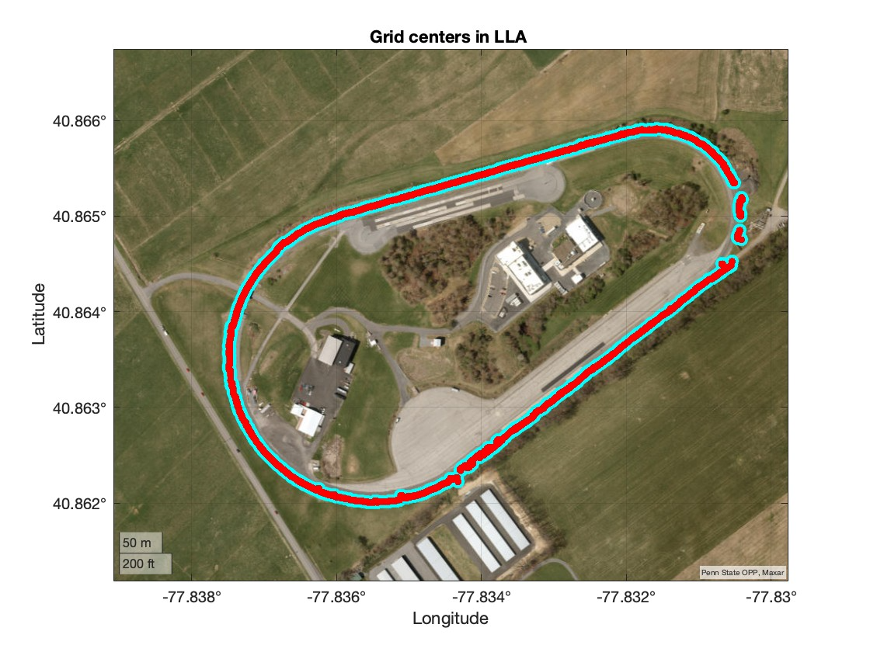
Boundary points of the test track are shown below

Slide 3
GIF of the boundary points

Slide 4
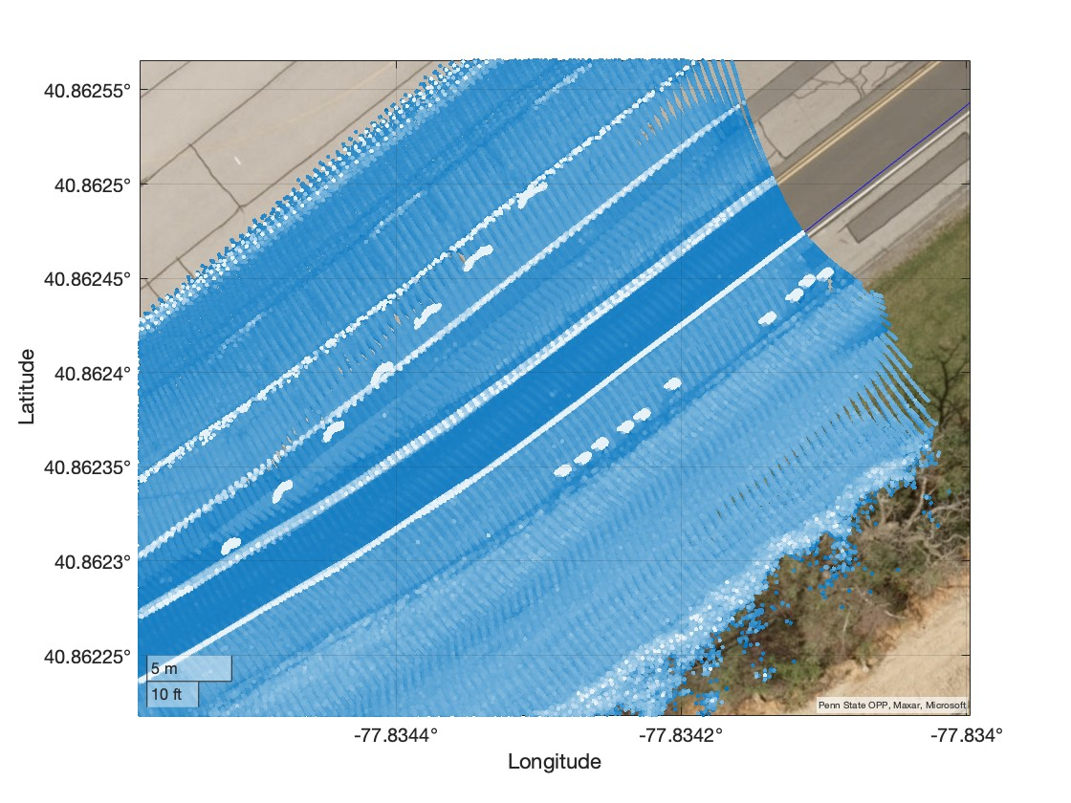
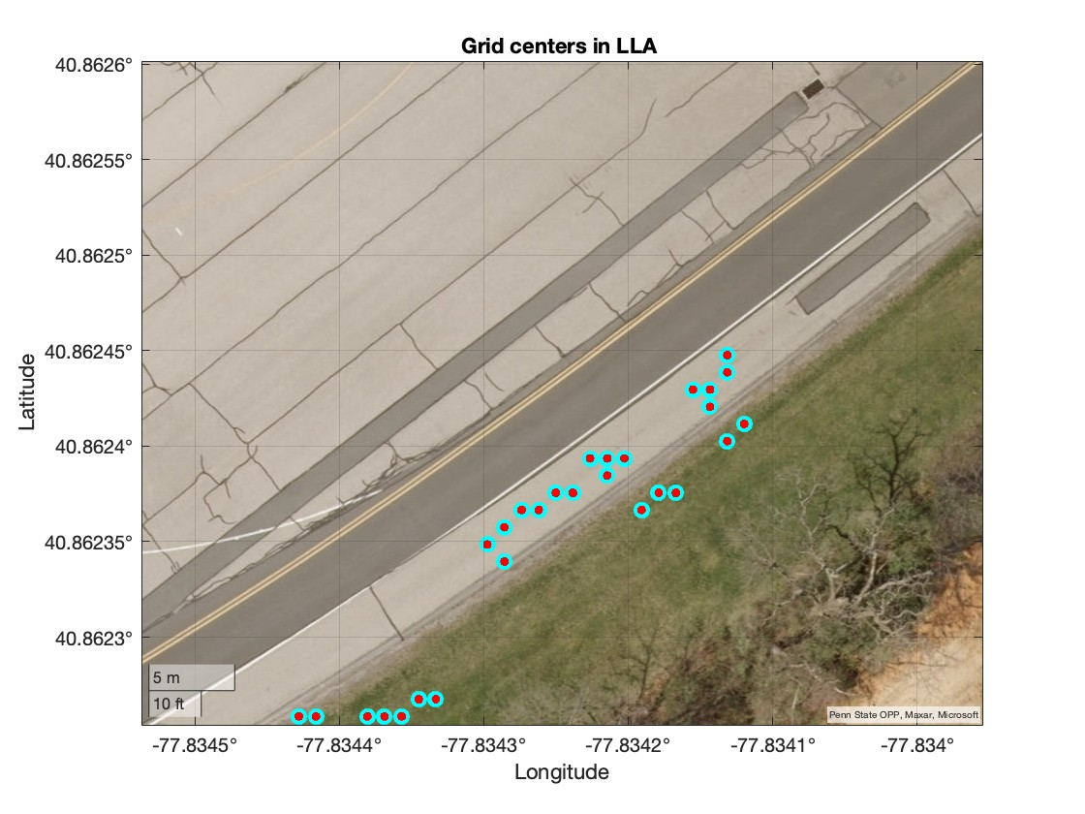
The barrels (obstacles) on the right edge are enclosed in a red circle on the LHS. The boundary points, also enclosed in a red circle, were not detected correctly due to these obstacles.

Slide 5
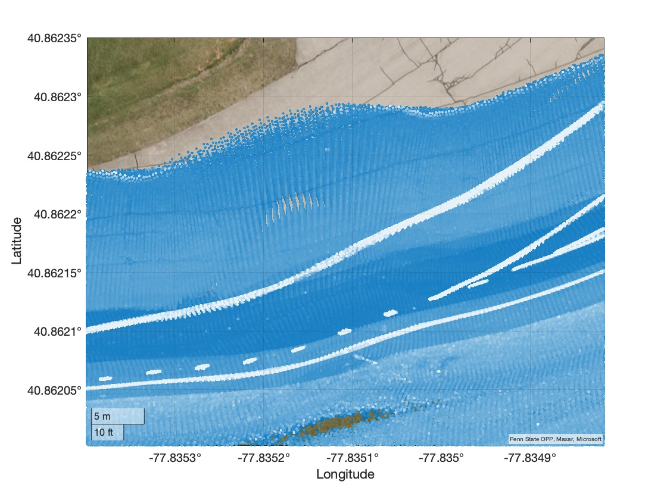
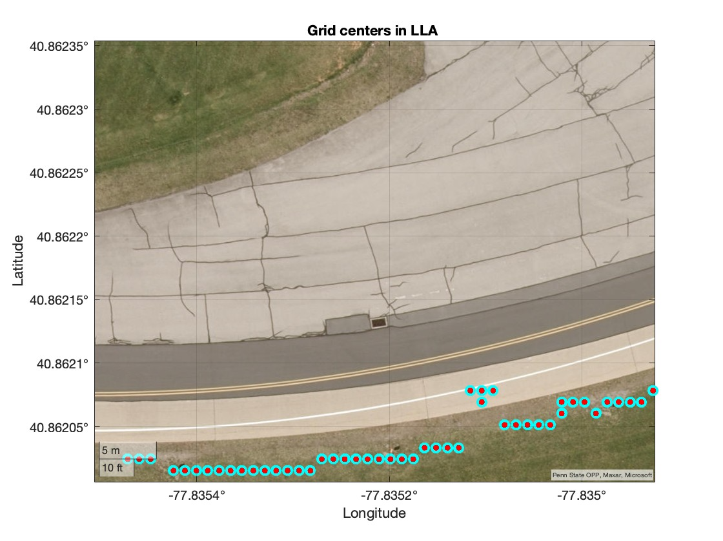
The barrels (obstacles) on the right edge are enclosed in a red circle on the LHS. The boundary points, also enclosed in a red circle, were not detected correctly due to these obstacles.

Slide 6
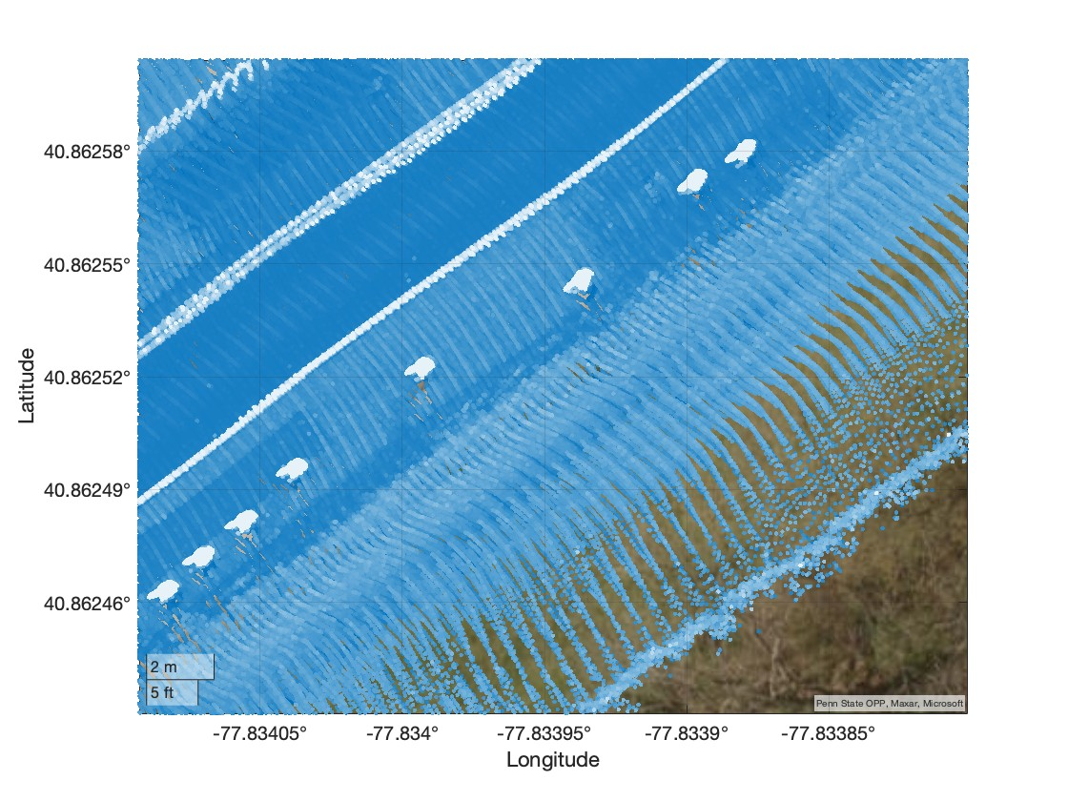
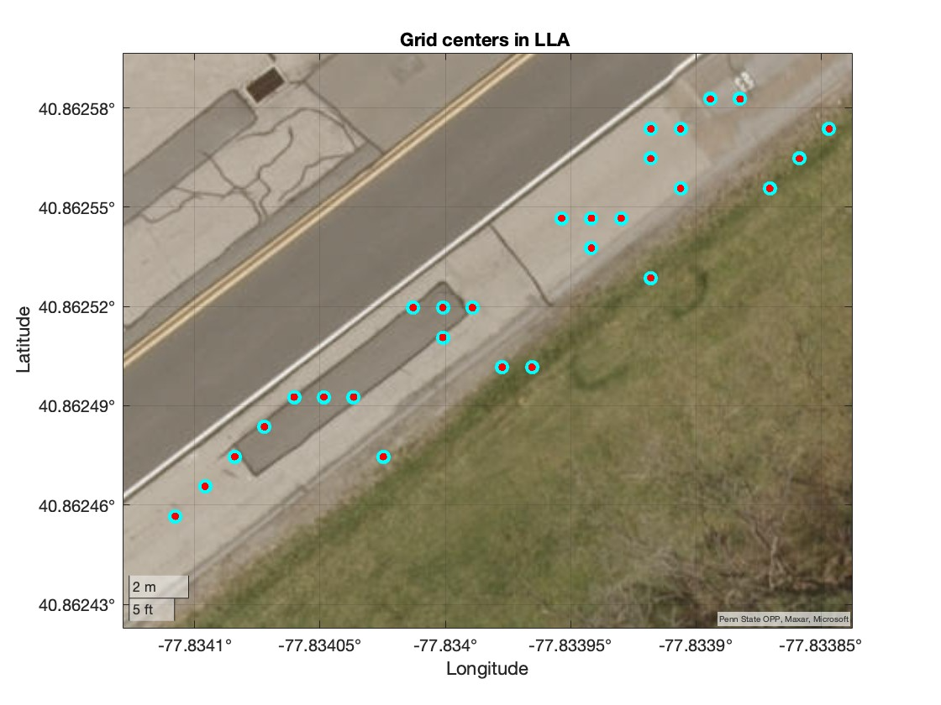
The barrels (obstacles) on the right edge are enclosed in a red circle on the LHS. The boundary points, also enclosed in a red circle, were not detected correctly due to these obstacles.

Slide 7
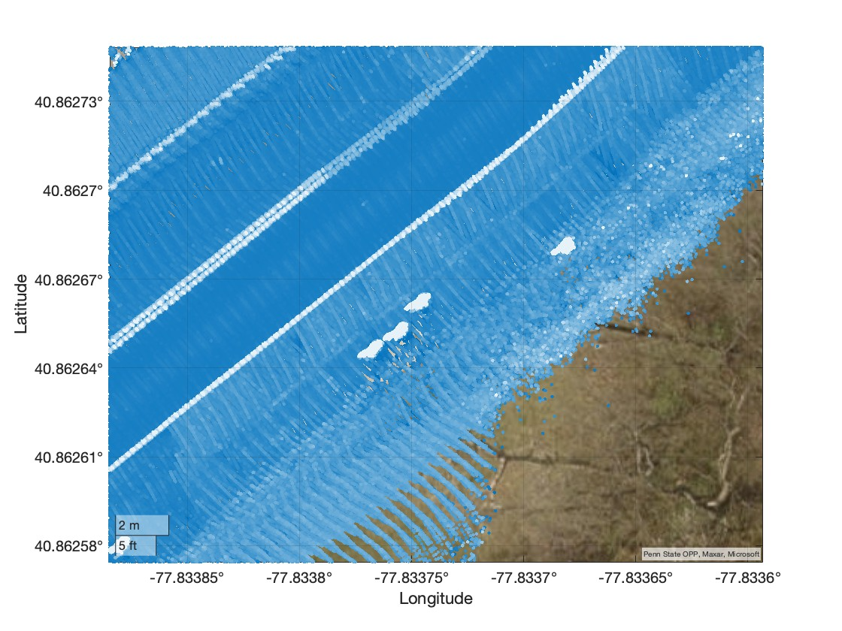
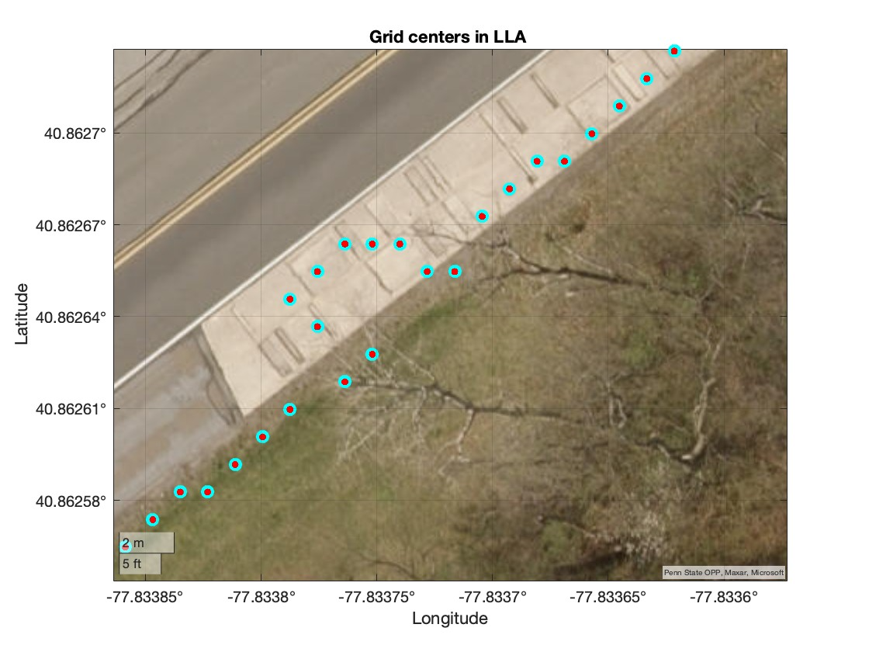
The barrels (obstacles) on the right edge are enclosed in a red circle on the LHS. The boundary points, also enclosed in a red circle, were not detected correctly due to these obstacles.

Slide 8
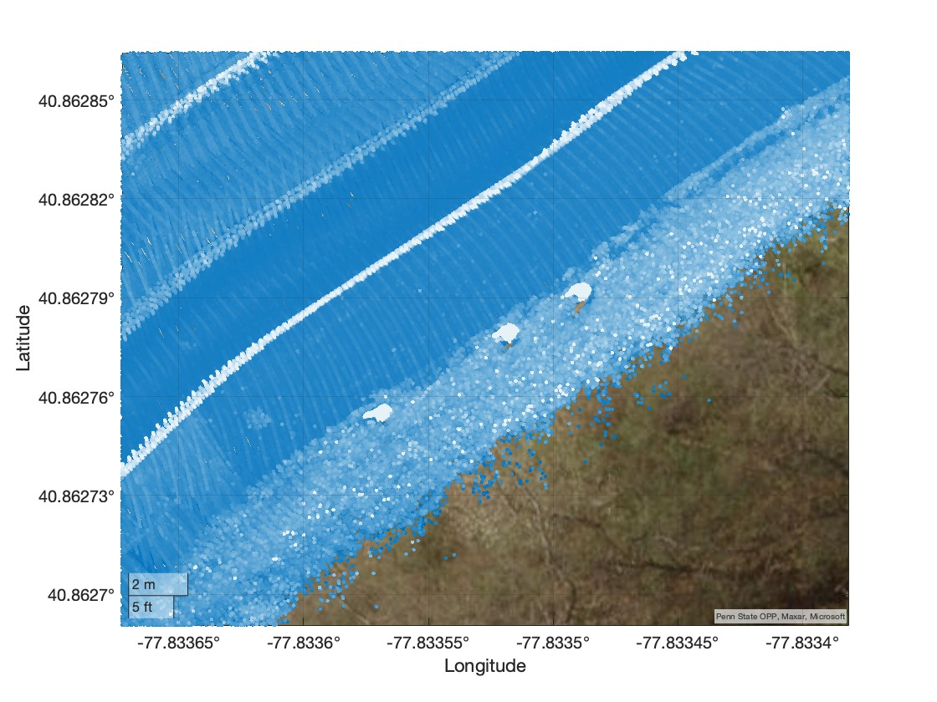
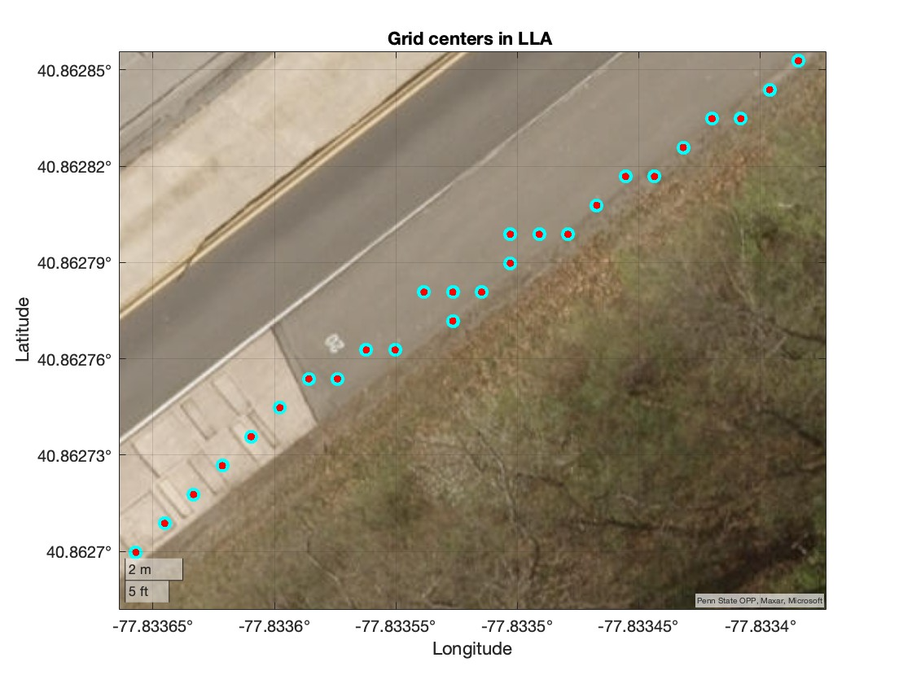
The barrels (obstacles) on the right edge are enclosed in a red circle on the LHS. The boundary points, also enclosed in a red circle, were not detected correctly due to these obstacles.

Slide 9
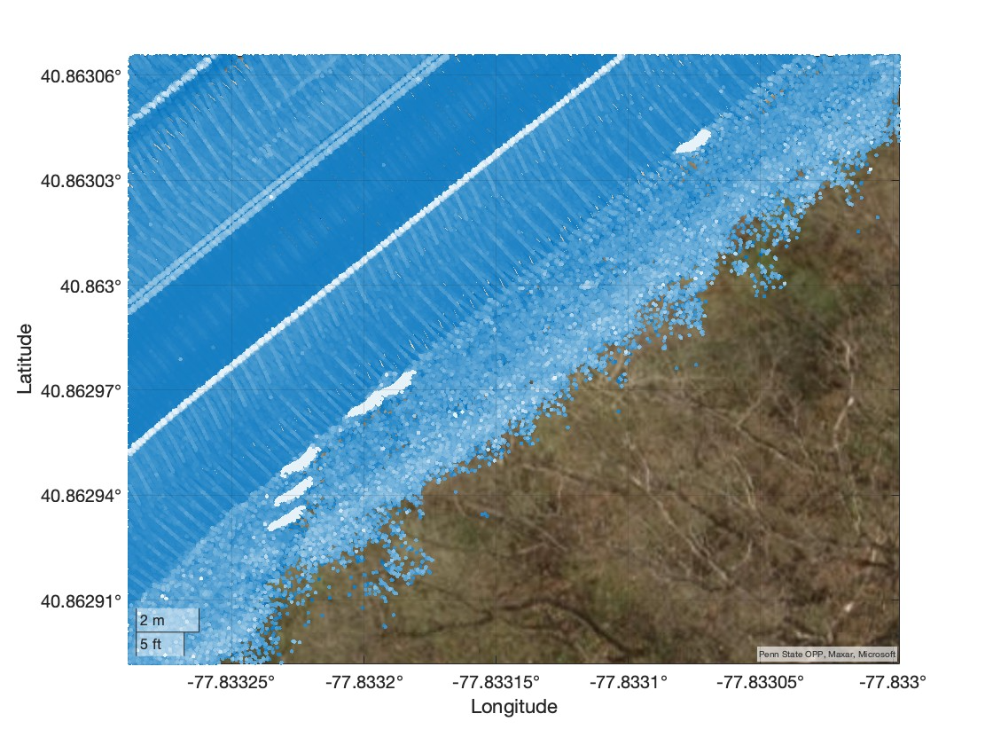
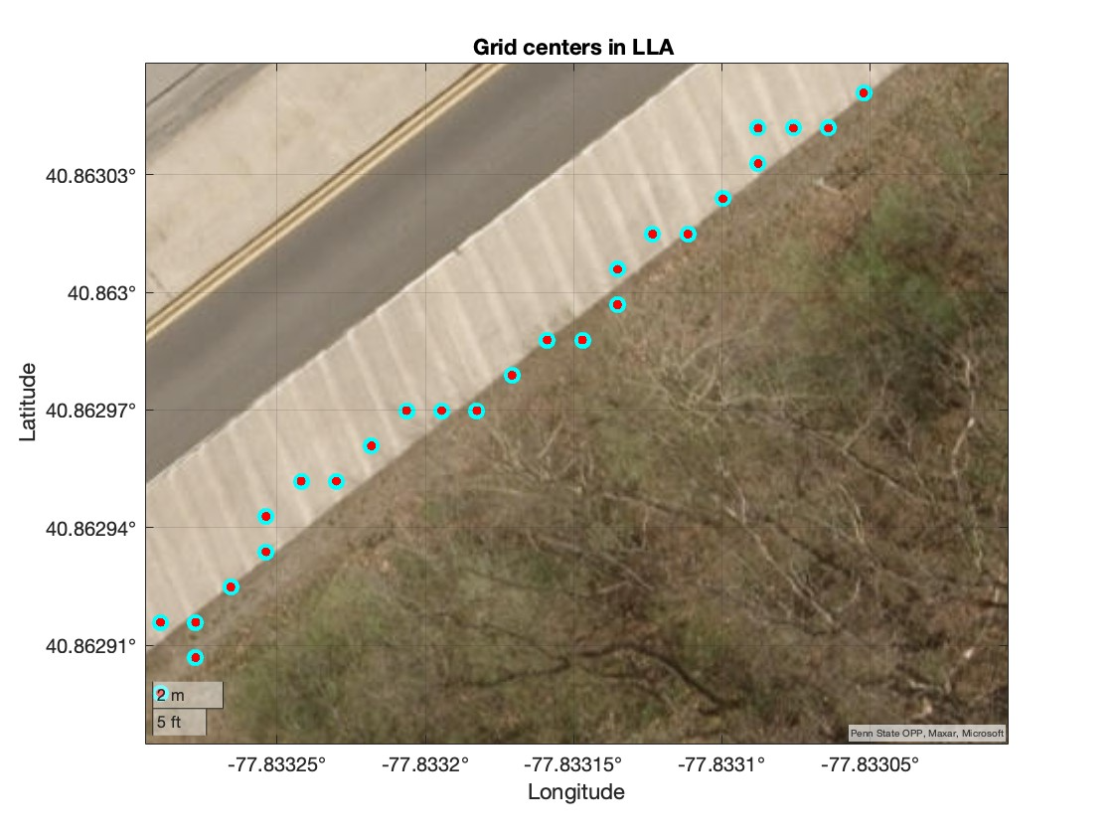
The barrels (obstacles) on the right edge are enclosed in a red circle on the LHS. The boundary points, also enclosed in a red circle, were not detected correctly due to these obstacles.

Slide 10
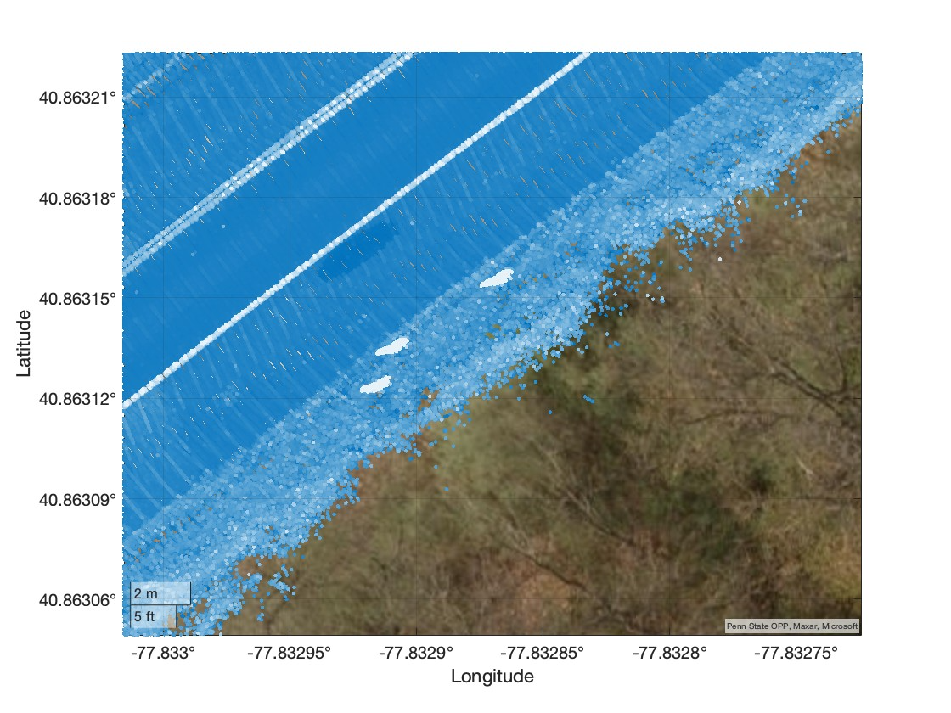
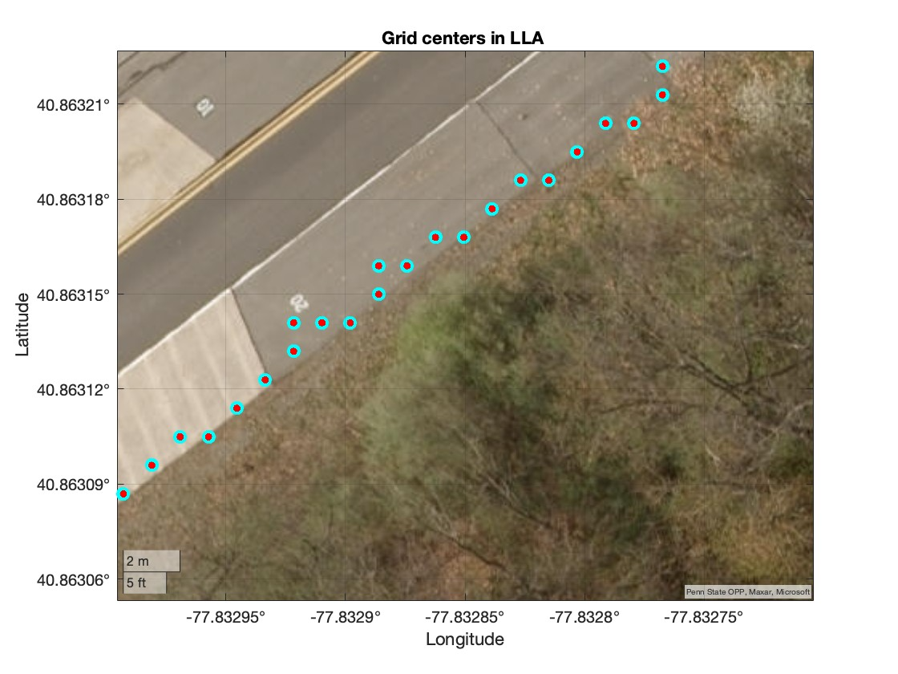
The barrels (obstacles) on the right edge are enclosed in a red circle on the LHS. The boundary points, also enclosed in a red circle, were not detected correctly due to these obstacles.

Slide 11
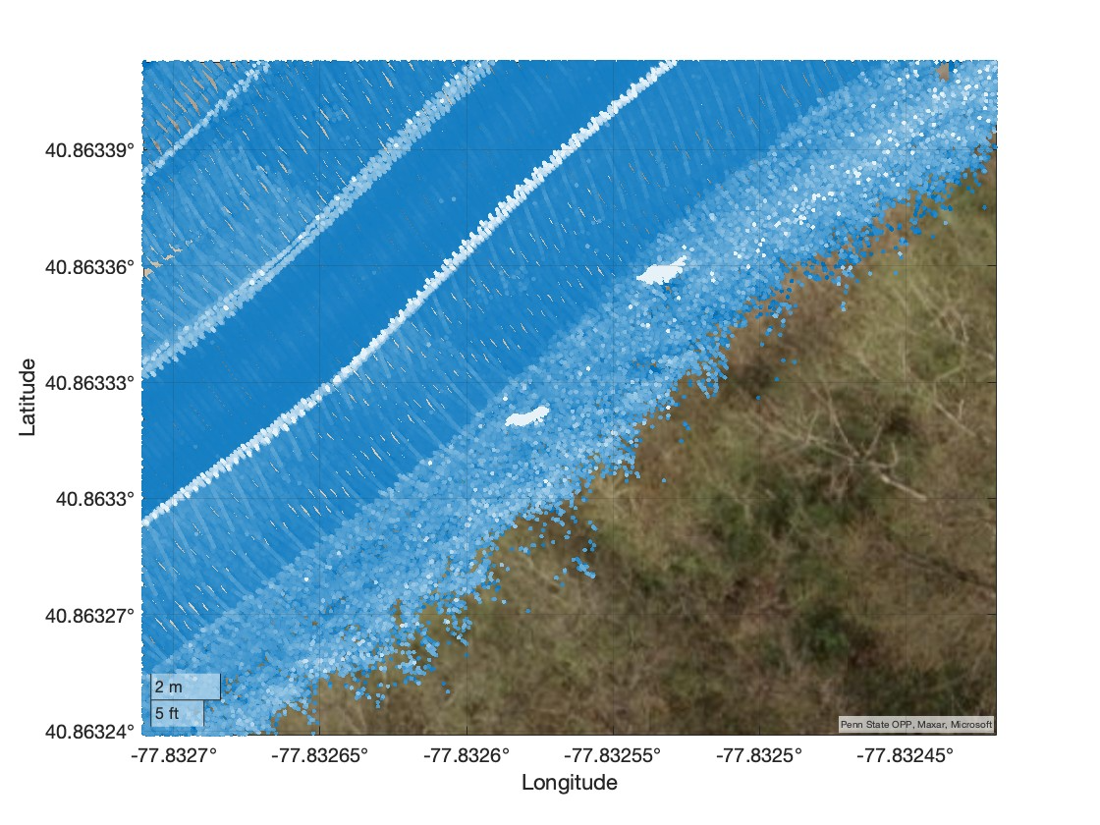
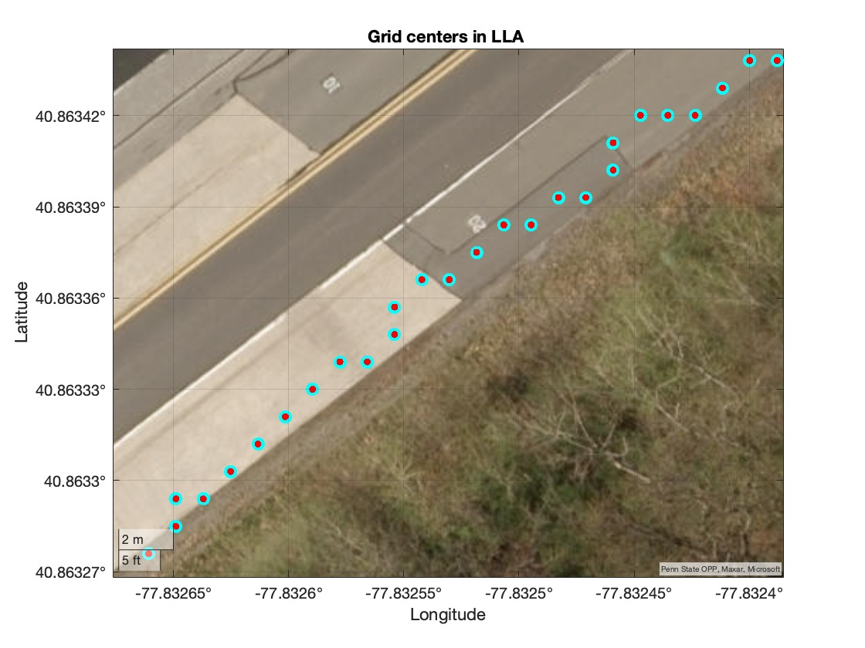
The barrels (obstacles) on the right edge are enclosed in a red circle on the LHS. The boundary points, also enclosed in a red circle, were not detected correctly due to these obstacles.

Slide 12
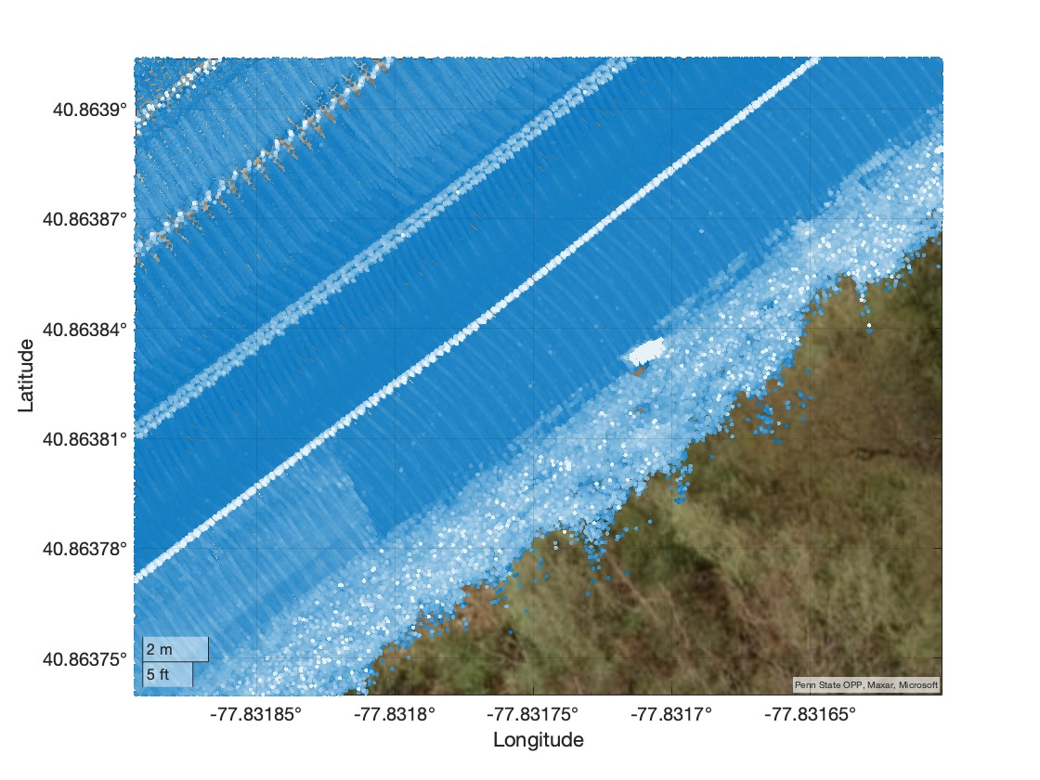
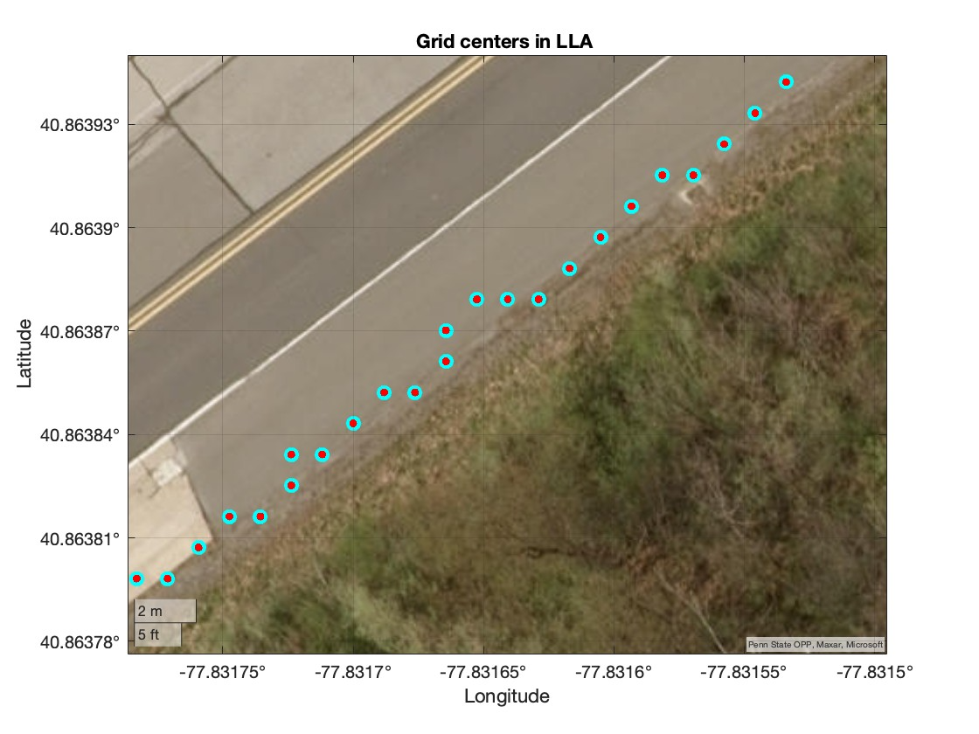
The barrels (obstacles) on the right edge are enclosed in a red circle on the LHS. The boundary points, also enclosed in a red circle, were not detected correctly due to these obstacles.

Slide 13
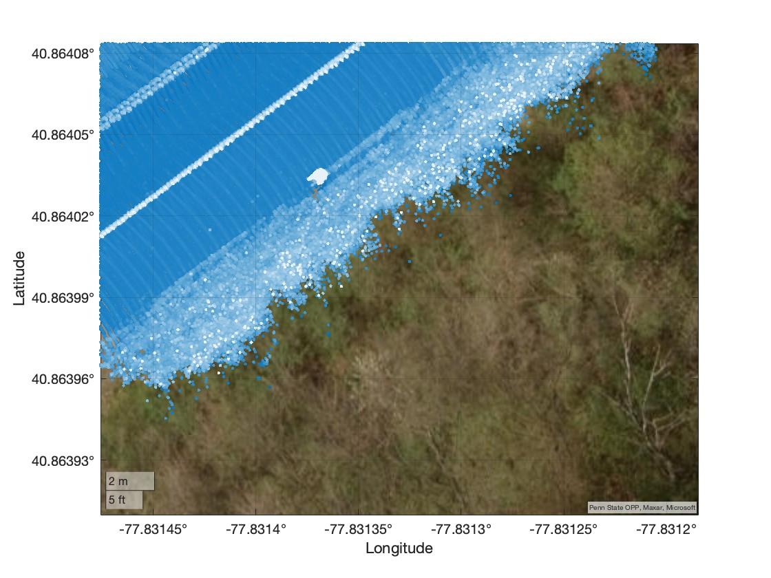
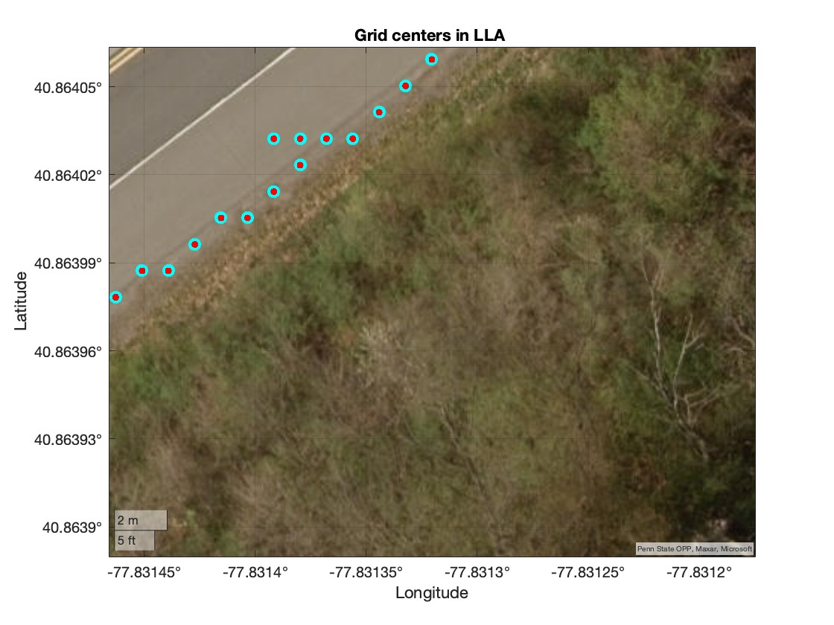
The barrels (obstacles) on the right edge are enclosed in a red circle on the LHS. The boundary points, also enclosed in a red circle, were not detected correctly due to these obstacles.

